Slide 1
Text summarization techniques using LLMs on patient interview transcripts post pediatric heart surgery
Shivani Betu

Slide 2
Introduction
Advantages of text summarization:
Save time
Improve readability
Ignore unwanted information
Use Cases:
In healthcare - summarize patient notes, patient interviews
News websites
Book summaries
Notes:
Aim of the project is to summarize long texts.
MAny uses in healthcare

Slide 3
Data Used, Objective of the Project and Approaches
Data used: Interview transcripts of patients and their parents post pediatric heart surgery.
Objective:
Summarize main topics capturing emotions of the participants
Provide insights into medical gaps and outcomes
Approaches:
map-reduce summarization of text without chunk overlap
map-reduce summarization of text with chunk overlap
map-reduce summarization of text with chunk overlap using custom prompts
passing summary of previous chunk in current chunk
title and summary generation of individual chunks in-order to generate final summary

Slide 4
Data Processing
raw text
Raw data is split into sentences
each sentence having a minimum of 20 words and a maximum of 80 words
limiting the chunk size to be the number of sentences it usually takes to express an idea.
5 sentences with a 1 sentence overlap between chunks
split to sentences
sentences from raw text
group sentences
chunks

Slide 5
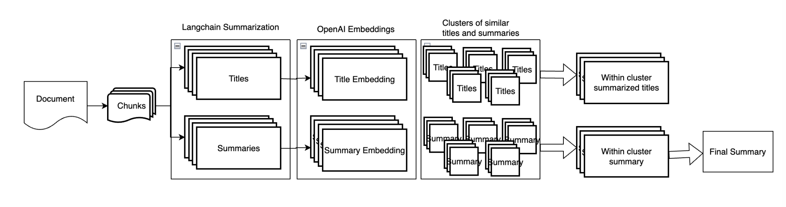
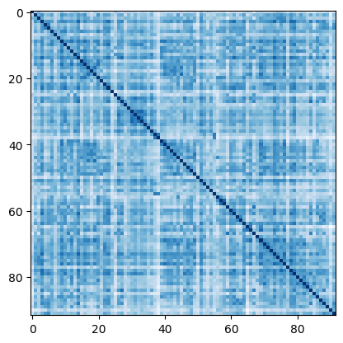
Methodology
Similarity matrix
Community detection algorithm

Slide 6
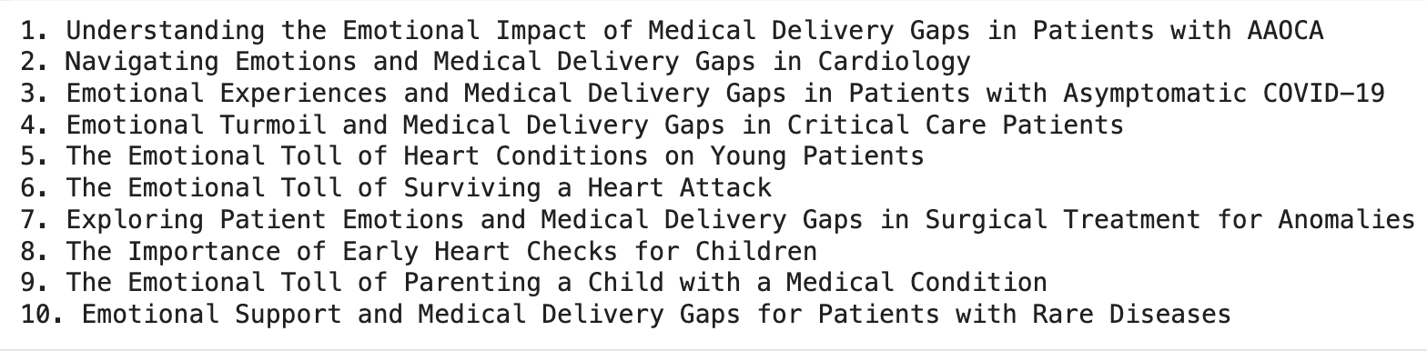
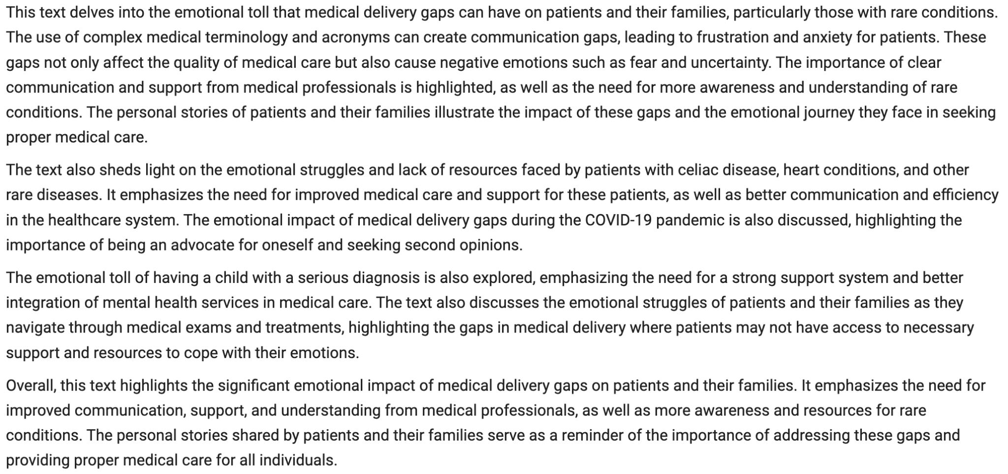
Results
Retrieve 10 topic titles from raw text (first figure on the right)
Can use one of the 10 topics to retrieve summary of each topic.
Overall summary of the raw text (second figure on the right)

Slide 7
Conclusion and Future Improvements
Conclusion:
The method proposed in the article was not only able to generate a detailed summary but it was also able to split text into different topics with corresponding summaries.
Potential future improvements:
Generate human summarizations, compare these results against them using similarity scores to see how good the results are and tweek the prompts.
Data cleaning and creating chunks:
creating a separate chunk for each interview question and using them as inputs to LLM
using interview question and each participant's reply as one chunk
Notes:
Text summarization is a tricky problem to solve. And we cannot analyze performance as there isn’t a way to generate accuracy without labels. The method proposed in the article was not only able to generate a detailed summary but it was also able to split text into different topics with corresponding summaries.
Further improvements could be creating a separate chunk for each interview question (this can retain the information and context of a topic which is an interview question in one chunk) and using them as inputs to LLM
using interview question and each participant's reply as one chunk so this can retain every information of that idea in one chunk.

Slide 8
Thank you

